Slide 1
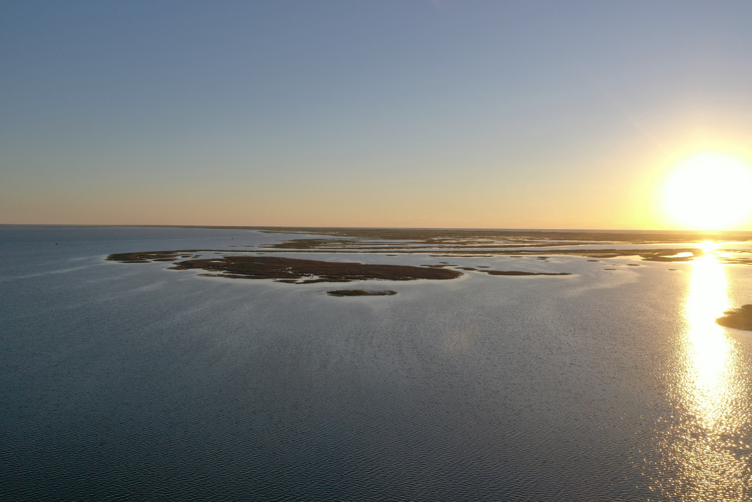


Quantifying Light Attenuation
from Suspended Sediment Plumes in Seagrass Beds
Laura Ramirez
Department of Physical and Environmental Science
Kirk Cammarata – Co-chair
Chris Bird – Co-chair
Richard Coffin - Member
Notes:
Creating a Geospatial Map of Light Attenuation from Suspended Sediment Plumes
Official logo of university
Program I am in
Committee members

Slide 2
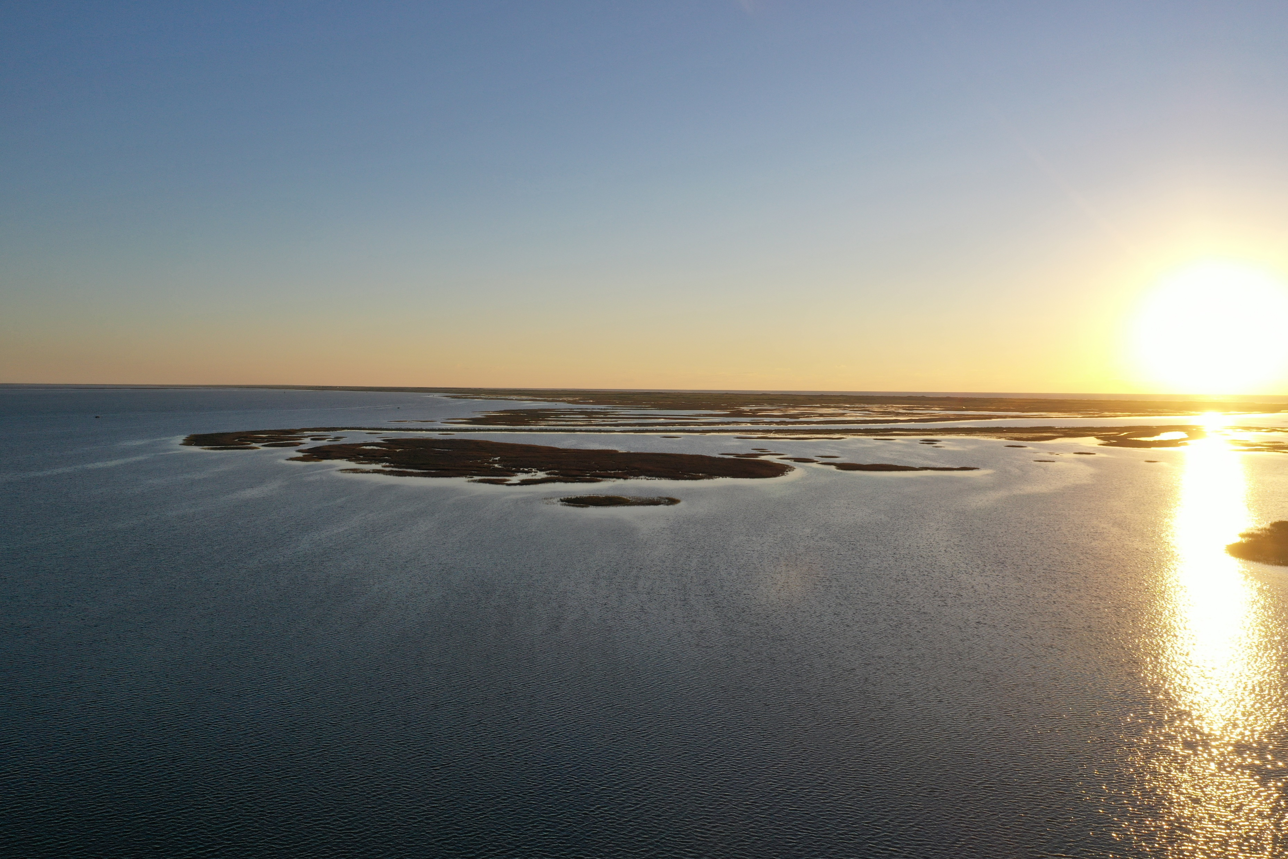
OVERVIEW
Importance of seagrass
Sediment Plumes and their effects
CMP Final Report - Previous data analysis of light logger capture
Steps for data collection and manipulation
Heatmap
Future research perspectives

Slide 3
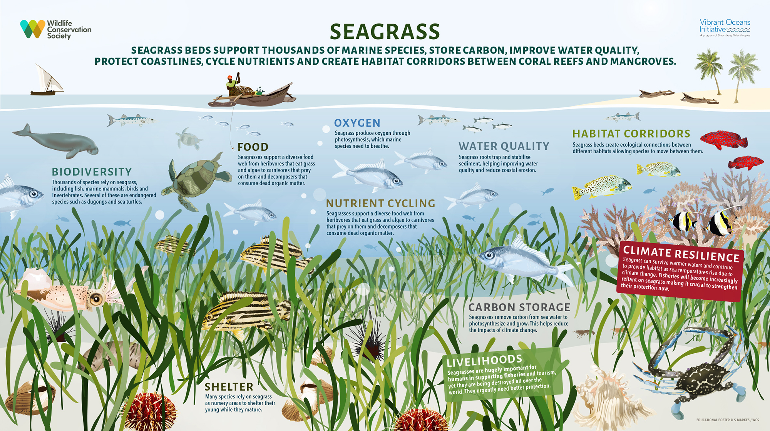
Seagrass Beds Have Multifaceted Benefits
Classes of Impacts
Biotic
Abiotic
Notes:
Reduce the size – heading that tells audience what to get out of poster
Classes of positive impacts – biotic, abiotic, etc

Slide 4
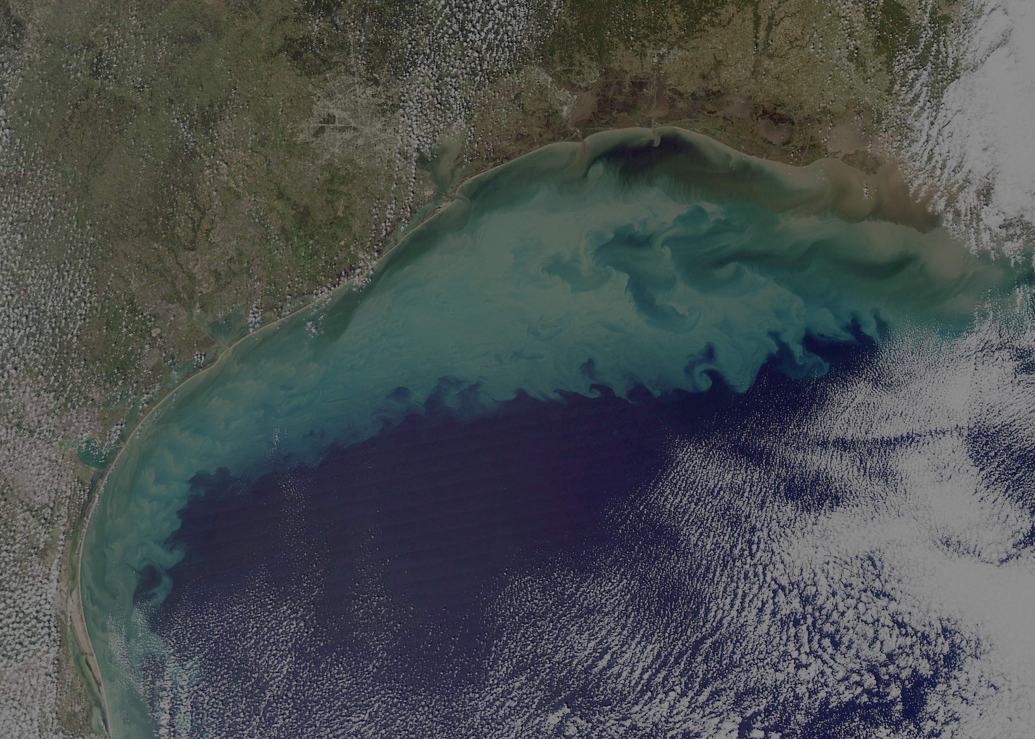
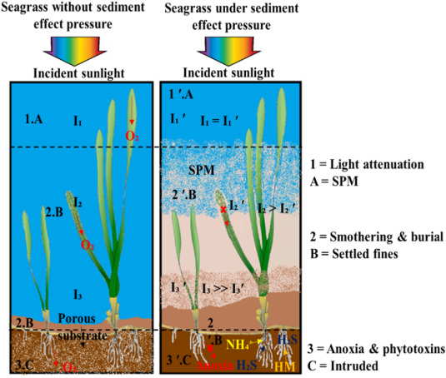
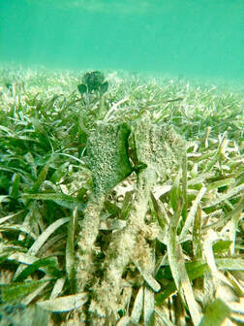
Sediment Plumes Negatively Affect Seagrass
Three Main Effects of fine sediment on seagrass
Light climate by suspended sediment
Burial with light attenuation and smothering
Alterations to substrate sediment
Notes:
Source of picture at the bottom – point out take home effect.
Fig. 1. Conceptual diagram showing the three main effects of fine sediment on seagrasses. Numbers indicate the damage mechanisms and letters indicate the locality where sediment stresses operate on the seagrass 1) Effect on light climate by suspended sediment, 2) Burial with light attenuation and smothering by settled sediment and 3) alterations to substrate chemistry by intruded sediment. A) Water column, B) Settled sediment on leaf surfaces or seafloor, C) Sediment intruded into the substrate pores. The substrate is represented as browner under high sediment loading to illustrate higher sediment bulk density, organic oxygen demand, and lower pore space. These three effects of mud may interact such that seagrass meadows are simultaneously stressed in three main localities by fine sediment. *Irradiance (I), Suspended Particulate matter (SPM), Heavy Metals (HM).

Slide 5
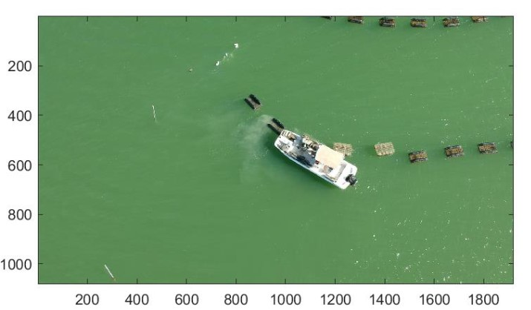
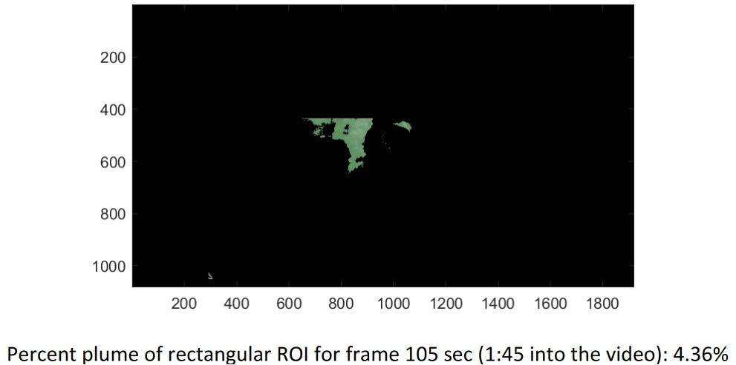
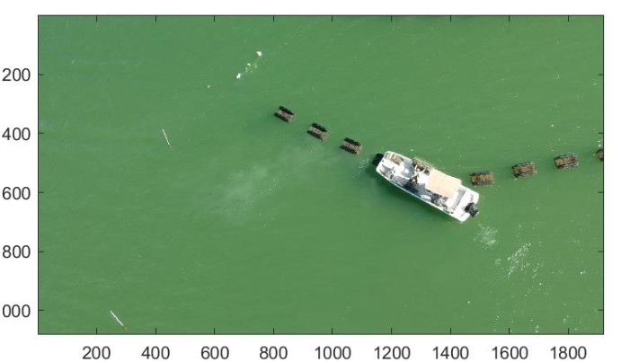
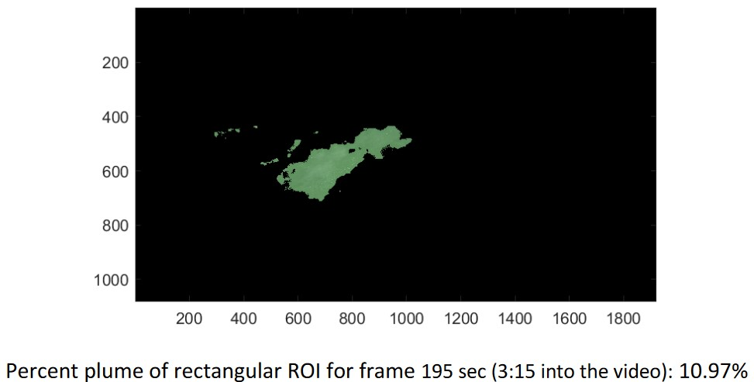
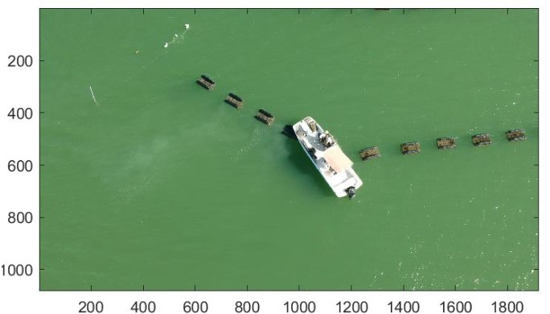
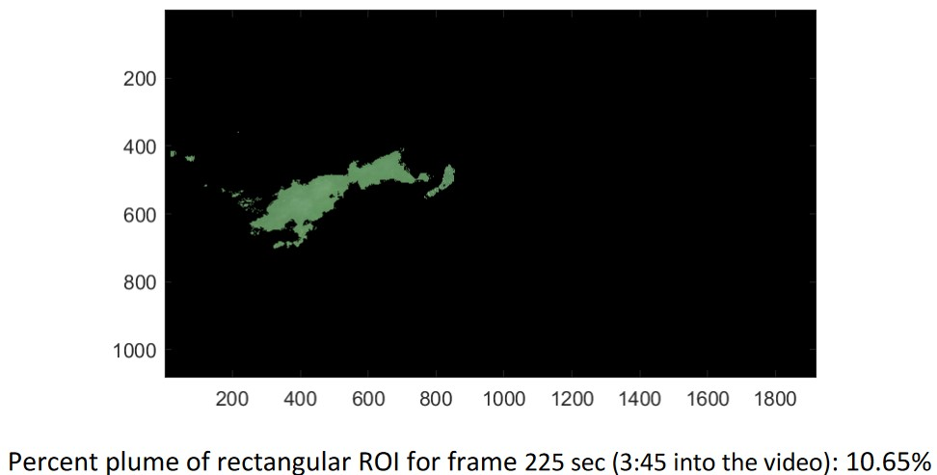
Studying the effect of sediment plumes on seagrass
Sediment plumes created by ship docking near Texas Oyster Ranch farm
Shuffling bags within cages, small plume of material is released when flipped back into water following handling
Notes:
Potential impacts of oyster mariculture on seagrass by generating sediment plumes.
Wanted to study how sediment plumes might affect seagrass
Not studying the effect of oyster mariculture on seagrass
Picture of COM site and plume (acknowledge project in the end)
En un experiment separado se obtivieron estos resultados – uno de estos parametros (light attn) fue usado como base para mi analisis
Talk about measurements on the seagrass sites – show a picture of sediment plumes from COM site. Show a picture from ingleside and sediment plume created by ship docking.

Slide 6
Oyster mariculture

Slide 7


CMP OYSTER MARICULTURE
Measure potential sediment generation at cultivated oyster mariculture (COM) operations in TX
Apply knowledge to simulate sediment plumes with similar characteristics at test seagrass beds, to measure if there were impacts to the seagrass.
Light Intensity parameter collected

Slide 8


Project Goal
Measure and visualize light attenuation caused by experimental sediment plume generation
Notes:
Understand light intensity behavior on experimental sediment plumes
Tidy field data to be processed into RStudio
Manipulate data to visualize percent light attenuation
Compare percent light attenuation values through all experiments in an area through the development of a two-dimensional heatmap of percent light attenuation values

Slide 9
METHODS

Slide 10
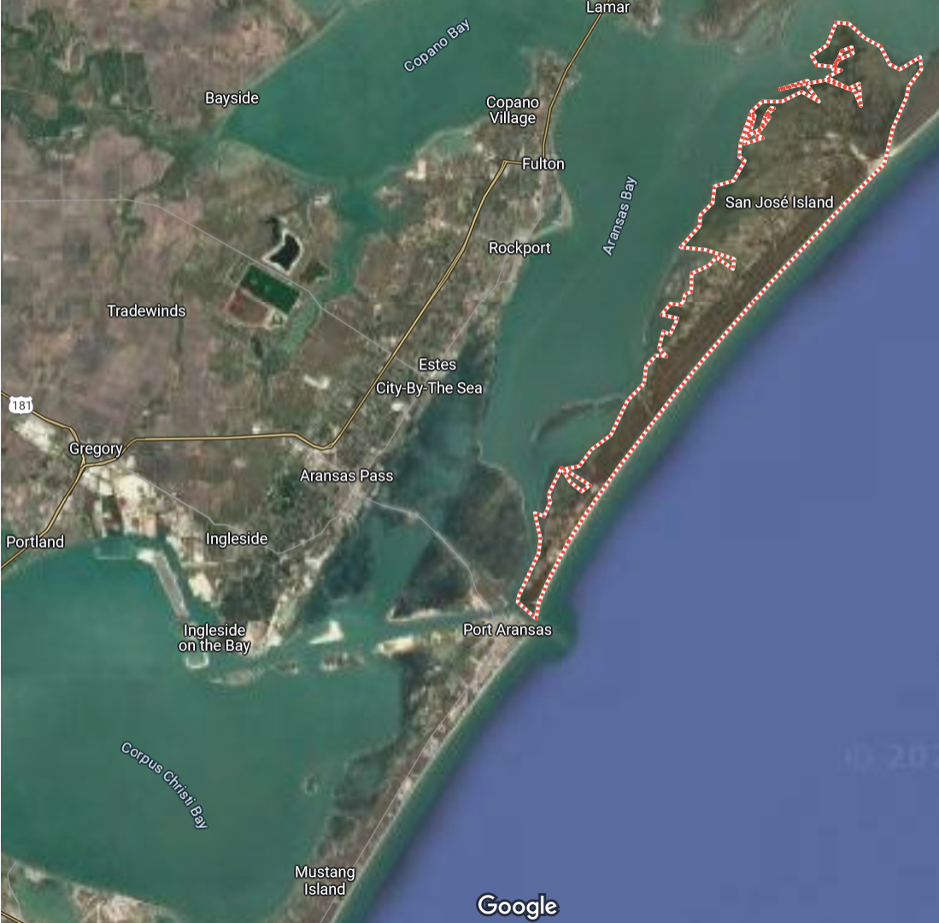
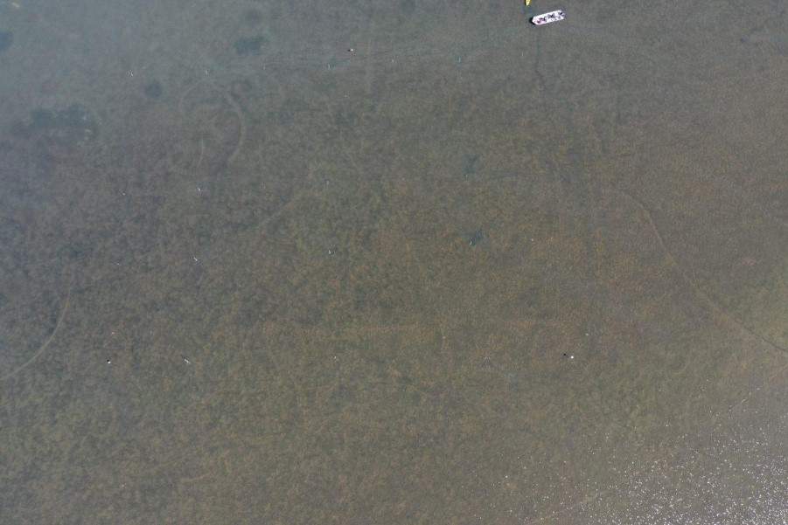
Study Site
Presumed prevailing wind
Presumed prevailing current
Notes:
The first Seagrass study site that was selected was located on the western side of San Jose Island Southeast from the Southern tip of Mud Island, near North Pass.
Depth at this location varied by up to 14 cm across the entire plot (mean depth 40 cm).
This site served as the seagrass study site with a sandy substrate.
Halodule wrightii was the predominant species, spread in a uniform pattern and density across the entire experimental plot.
The experimental plot was rotated to the Northeast with the baseline following the compass heading 30 degrees ~NE. This was done to match prevailing wind patterns in the area coming out of the Southeast.
(Weather forecasts and conditions for this site were obtained from using the Port Aransas (Inside) weather station on Willy weather)

Slide 11
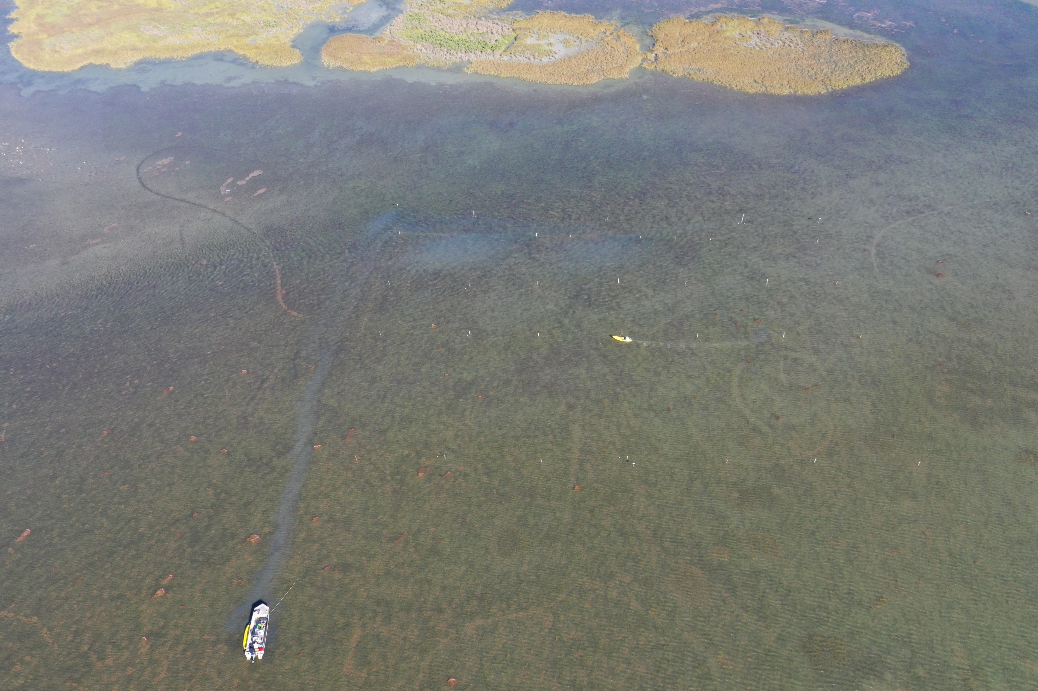
Experimental Design
Track 1
Track 2
Track 3
Grid Layout
Tracks
Zones
Label disturbance baseline (og design)
200 ft
200 ft
100 ft
50 ft
300 ft
Notes:
Flip image up
Talk about sediment plume generation

Slide 12
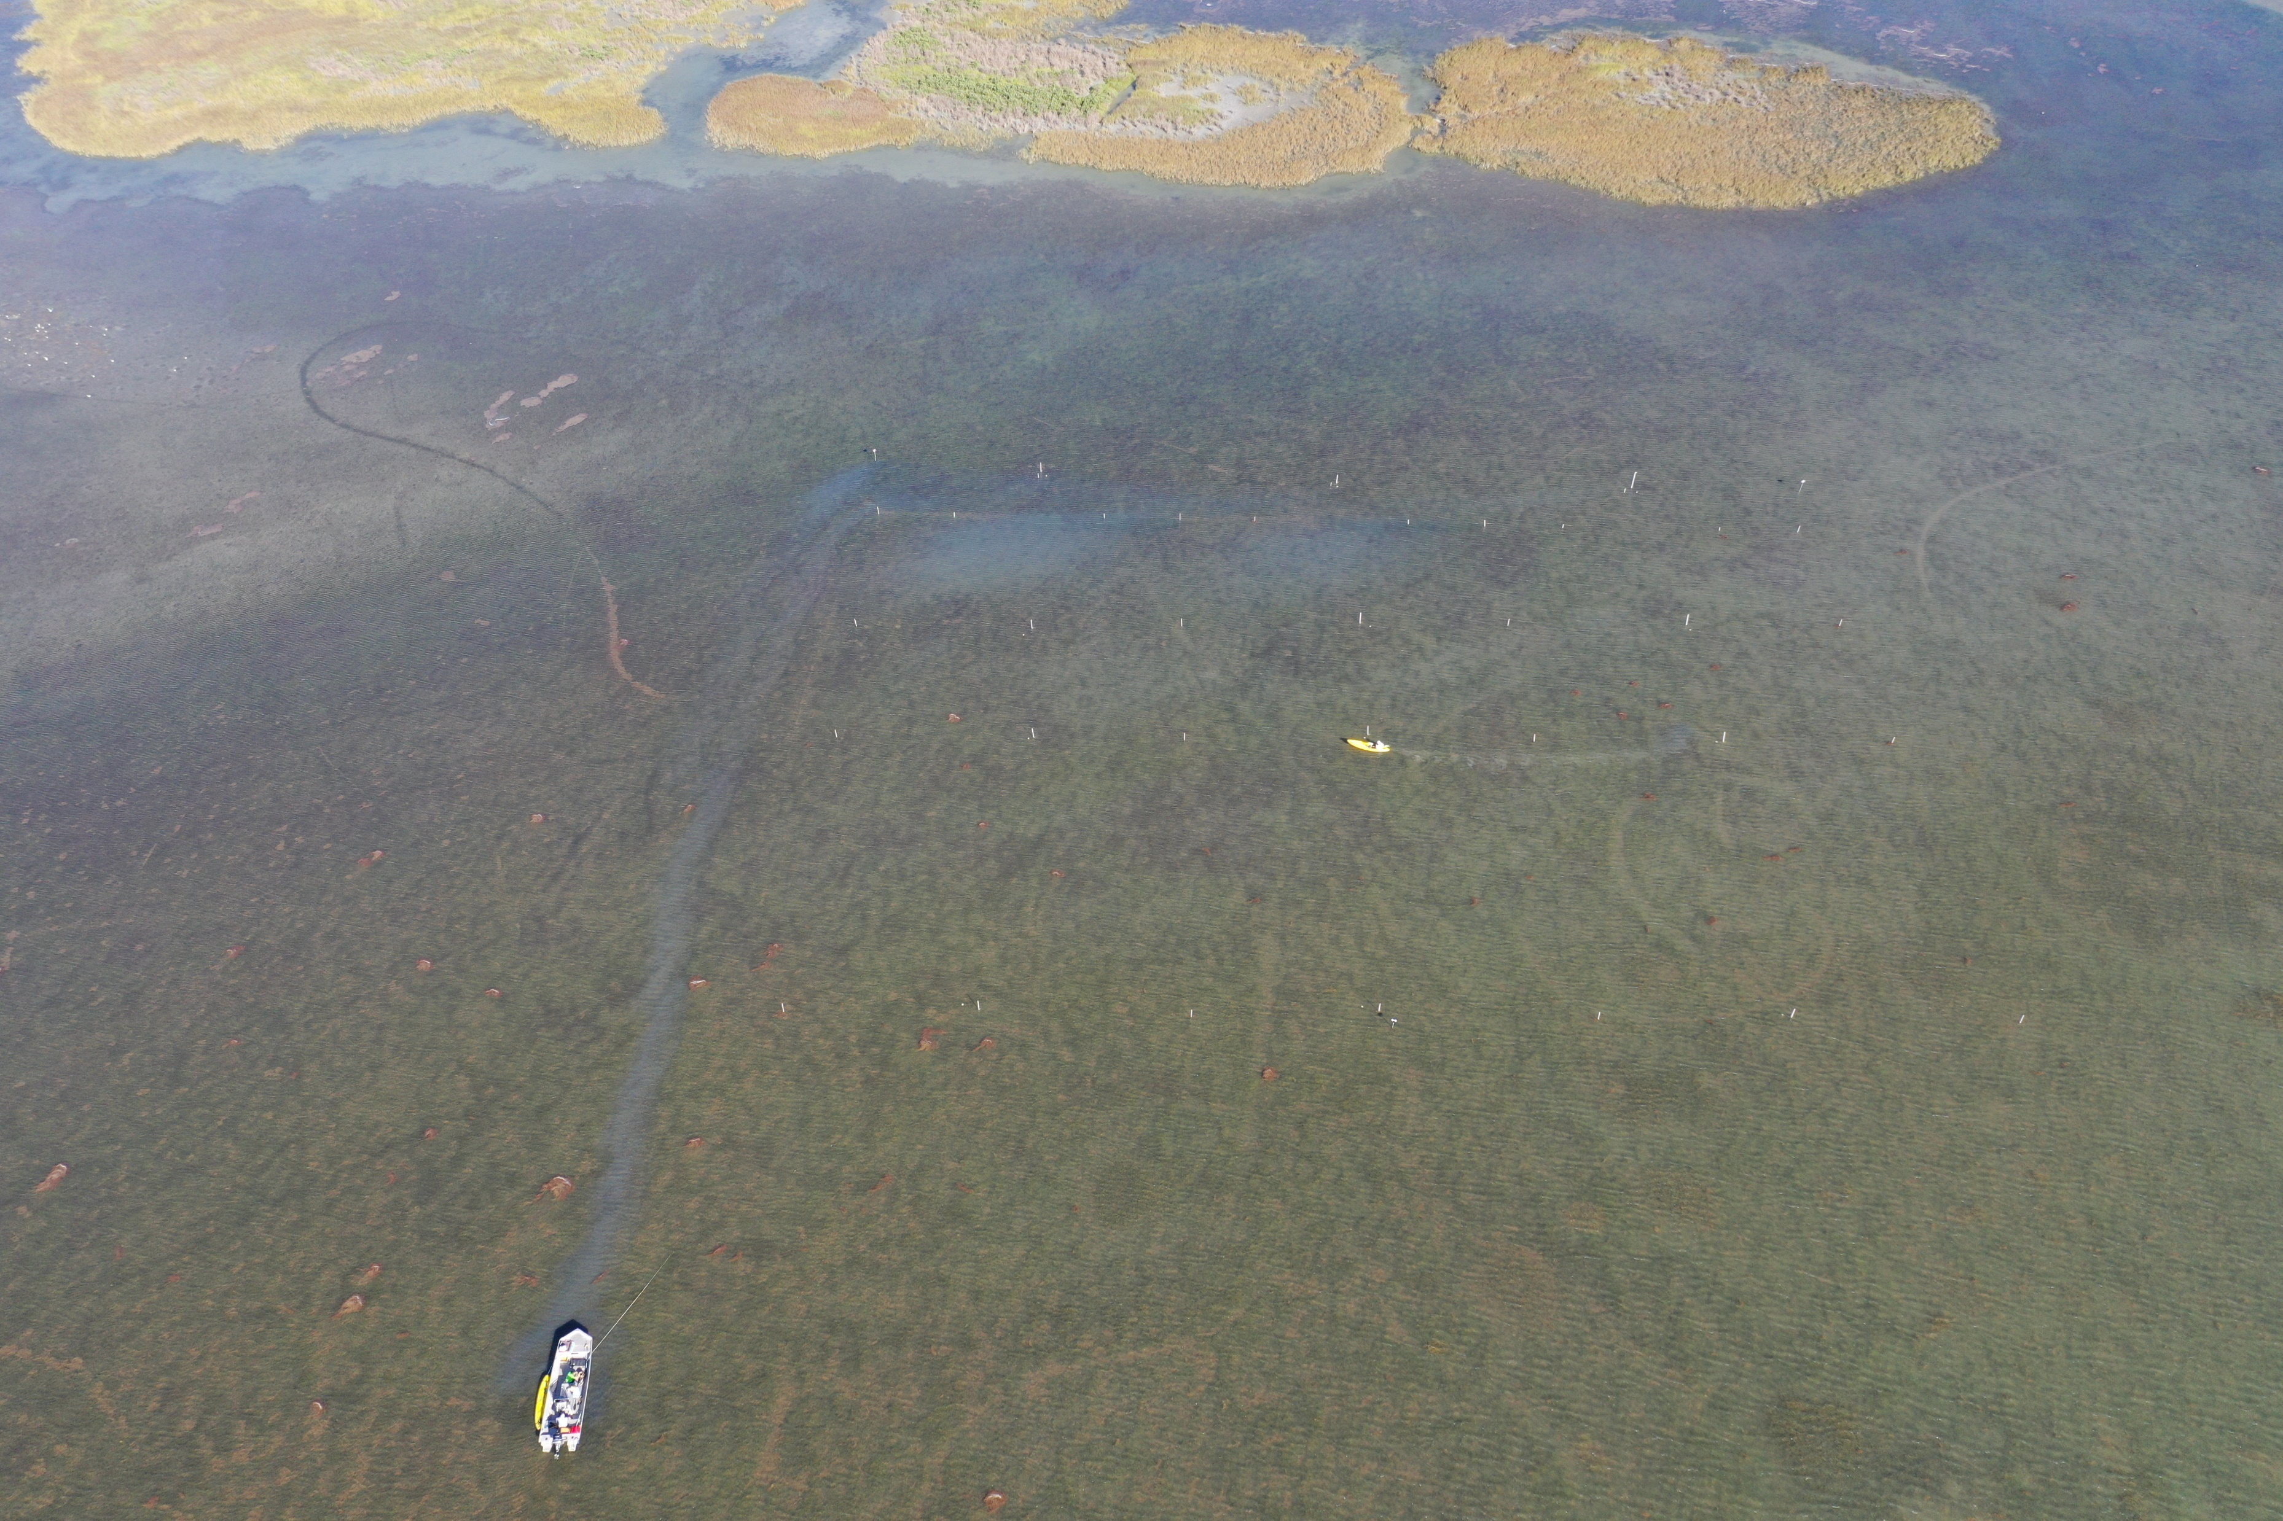
Experimental Area
Track 3 Track 2 Track 1
300ft x 200ft
3 different tracks (1,2,3)
3 zones (A,B,C)
Upstream Zones
Zone A
Zone B
200 ft
Zone C
300 ft
Notes:
Start with all elements, make 3 copies, to create maps
Define tracks and zones, replace slide 11.
Add disturbance areas (to calibrate audience to maps later) – include units.
1- white grid (experimental area)
2- white and yellow poles ll positioning)
3- white yellow and brown (disturbance location)

Slide 13
Generating Sediment Plumes
Artificial plume created by walking along the up-current edge of the plot, in a standardized fashion, kicking up sediment plumes.
Notes:
Video would be helpful
10/1/2022 1 9:21 9:41 20.00
10/1/2022 2 10:16 10:36 20.00
10/1/2022 3 11:08 11:18 10.00
DJI0835 - video

Slide 14
Light Logger Positioning
I
E
A
Twelve light logger poles
Labeled A thru L
J
F
B
K
G
C
L
H
D
Notes:
Standard layout – 4 poles per track
Needed to be modified because of poor results

Slide 15
Disturbance Location
I
E
A
Track 3 – Heavy Disturbance
Track 2 – Medium Disturbance
Track 1 – Light Disturbance
J
F
B
K
G
C
L
H
D
Notes:
Thicker dist line

Slide 16
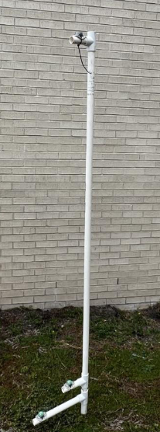
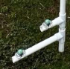
Light Logger Setup
Top Logger
Bottom Logger 10cm off the bottom
Loggers have individual serial numbers going permanently to a specific pole
Separated in depth by 13cm
Notes:
Rebar placed inside PVC to hold upright
Peg inserted to lowest PVC to prevent turning due to currents
Try to get better picture of logger and have arrows explaining instead of text
Hand Motions
Mention airlogger – not used in our analysis
Explain HOBO lightlogger – instrument que collecciona intensidad de luz y temp a traves de sensors fotoelectricos y recoge la informacion digitalmente para posterior prcesamiento

Slide 17
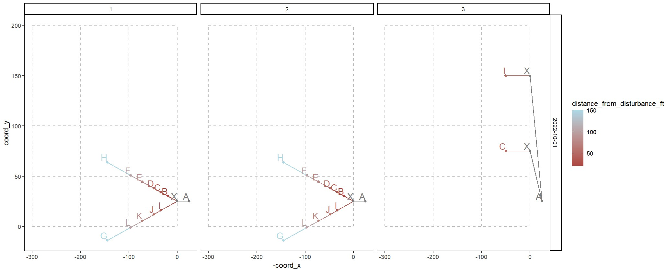
Temporal Sampling Design
Multiple Disturbances
Within a day 2-3 disturbances were made (on avg 1-2 disturbances per week)
Data Collection Times
Interested in Light Attenuation occurring during disturbance periods
Notes:
Talk about the times experiments were done. Talk about multiple disturbances. Talk about how within a day 2 to 3 experimental disturbances were made. Talk about data collection times.
Interested in light attn occurring during disturbance periods. Waited enough for plumes to go away before next disturbance. – flash few images of how poles were laid out. (wasn’t always the same) – slide 13 first one to show
Opportunity to show computer plotted depictions of experiments. – not added BUT Be ready to explain how notes were taken sometimes of the pole placements. (compass heading) used trigonometry to figure out XY coordinates.
Show picture of disturbances (people walking on tack baselines)

Slide 18
Creating Relational Database
Light Logger Files
Arranged according to date and loggerID
Light logger intensity
Light Logger Metadata
Assignment of logger files to date and poleID
Light Pole Metadata
Cartesian coordinates from each light pole by disturbance experiment
Disturb Exp
Start and stop time of each disturbance
Light Logger Metadata
Date
PoleID
FilePath
Light Pole Metadata
Date
PoleID
DisturbID
DisturbExp Metadata
Date
DisturbID
Time
Light Logger Files
Date
FileName
Time
Notes:
Connect time to time
Bulletpoints – talk about each file (visual aid to show how each connects)
Zoom in on one and explain

Slide 19
Data Processing Workflow
Input
Script
Output
Light Pole Metadata.xlsx
calc_coordinates.R
Pole Maps.pdf
DisturbExp Metadata
processed_coordinates.rds
Attenuation Plots.pdf
Relational
Database
Light Logger Files
Sector Heatmaps.pdf
wrangle_light_logger_data.R
Light Logger Metadata
Notes:
Scripts – represented as a rectangle, not code. What it is doing in relation to data files.
R scripts (2). Studio – makes it easier to develop Rcode
Different color of scripts
Represent files going into script
Inputs – script – outputs (label on ppt)
Change color of Rscripts
Make everything the same dimensions
Have text pinned to the top and pdf are portrait

Slide 20

Estimating Light Attenuation
Relative Difference, defined as the difference in light level between an upper logger and a lower logger​
Divided by the upper logger reading​
Provides a metric that corresponds to the percent of incident light at the top logger that is attenuated by the water column before it is perceived by the lower logger
($\frac{Light Logger 1 −Light Logger 2}{Light Logger 1})∗100$
Notes:
Involve equation being used. – bullet points describe how equation works.
Relative Difference, defined as the difference in light level between
an upper logger and a lower logger, divided by the upper logger reading, provided a metric that
corresponds to the percent of incident light at the top logger that is attenuated by the water
column before it is perceived by the lower logger. Plots of Relative Difference show passing
sediment plumes as an increase in the difference over time. Alternatively, sediment plumes
could be detected as changes in the area beneath the curve representing the total light
received. This allowed calculation of the total reduction of light experienced (light budget)
during a sediment disturbance plume and indicated the persistence of the plume.

Slide 21
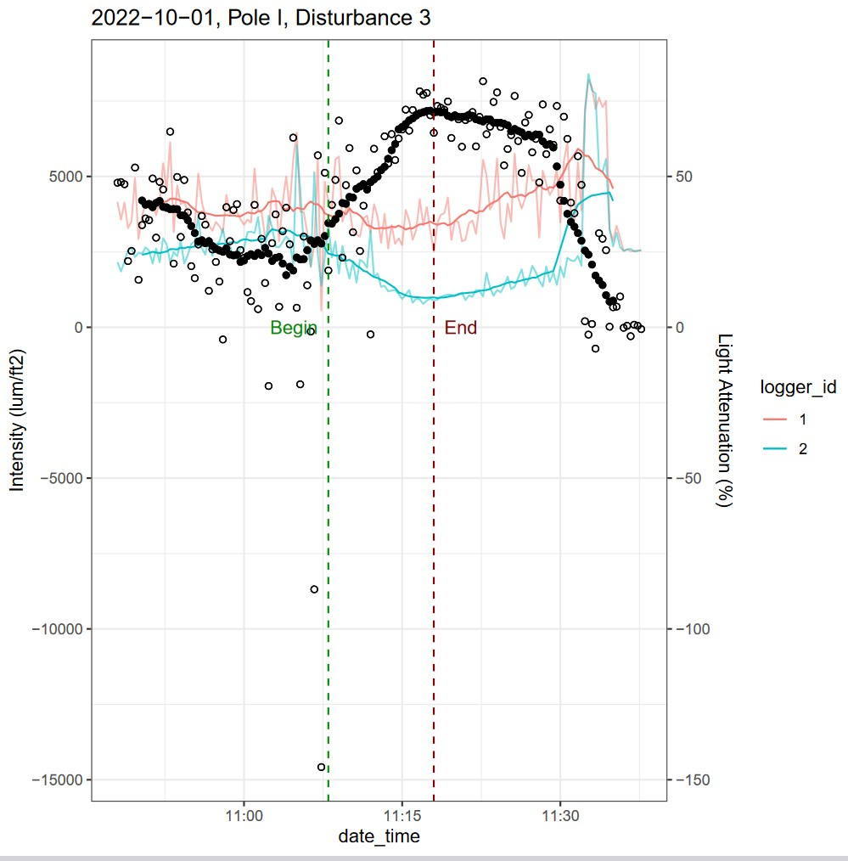
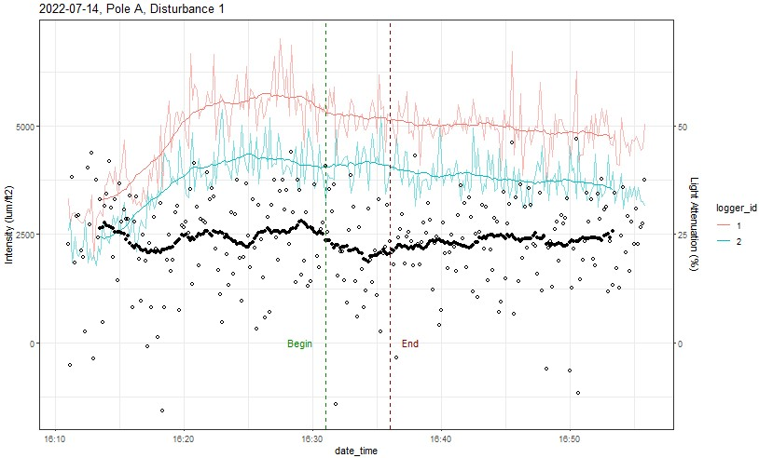
Visualization of Percent Light Attenuation
Interested in intensities within disturbance timeframe
As light intensity decreases, light attenuation increases
Light Intensity
Light Attenuation
Instantaneous
5 min average
Notes:
1.
Go after light attn measured. (example output)
Use a different day – use a better example (10-01-2022 better)
Add description of intensity, attenuation
Make a Legend
Light Intesnity
Logger ID 1 and 2
Make a normal figure legend
Light intensity logger ID

Slide 22
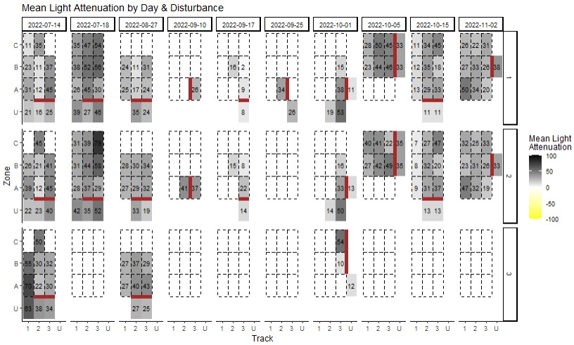
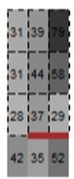
Converting Data Into Zones and Tracks
T1 T2 T3
Within a disturbance and within a unique zone-track square (sector), light attenuation values were averaged across all poles
Average the mean within a disturbance across disturbances
Average this average across dates to have one value per track-zone grid
Zone C
Zone B
Zone A
Upstream
Disturbance
Location
Notes:
Talk about how within a disturbance and within a unique zone-tack combo, light attenuation values were averaged across all poles.
Averaged the mean within a disturbance across disturbances, for the whole thing we averaged across the dates.

Slide 23
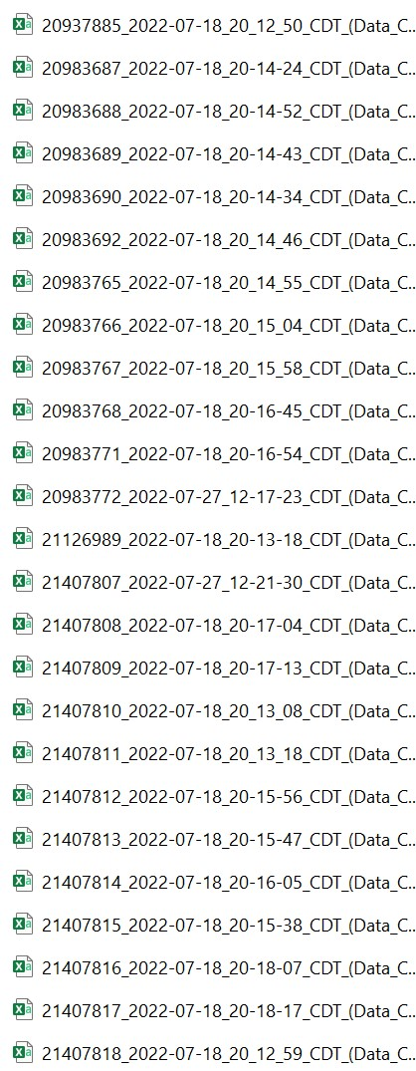
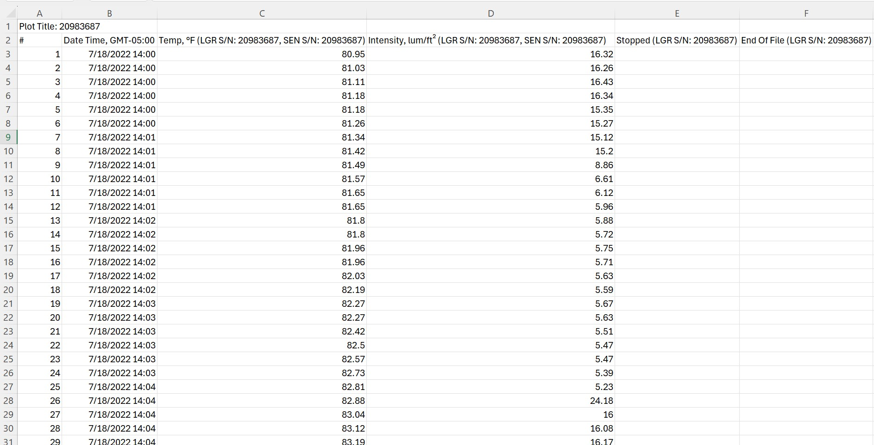
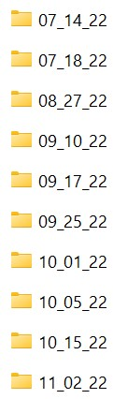
Raw Data Collected by Light Loggers

Slide 24
Experimental Design
(300,200)
(200,200)
(100,200)
(0,200)
Coordinate System
Inverse on x axis
(300,100)
(200,100)
(100,50)
(0,100)
(300,50)
(200,50)
(100,50)
(0,50)
(300,0)
(200,0)
(100,0)
(0,0)
Notes:
Facilitates defining light logger pole position

Slide 25
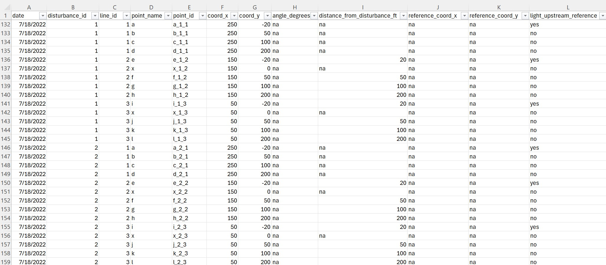
Tidying Up Data for RStudio

Slide 26
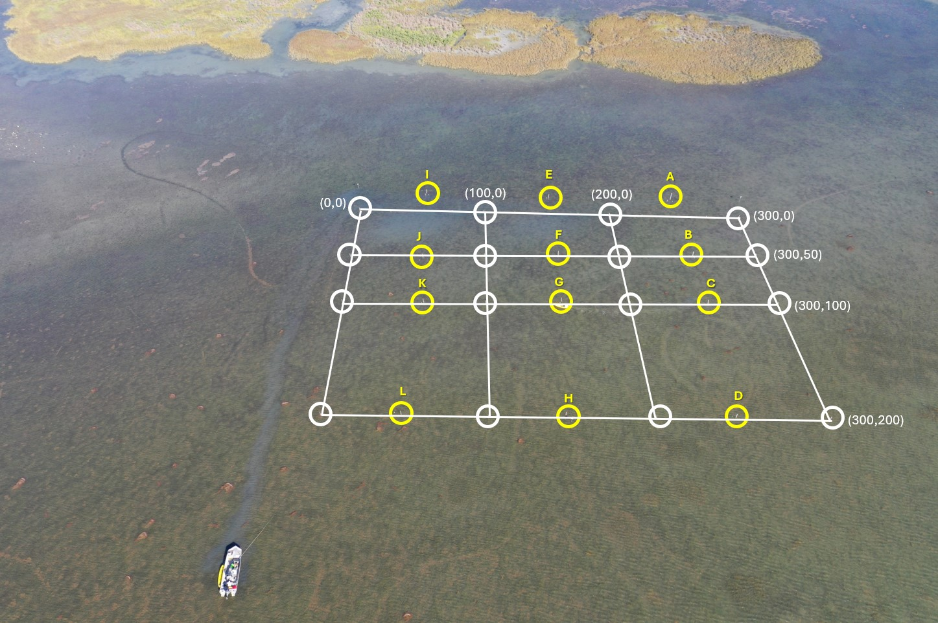
07-18-2022 Experimental Layout

Slide 27
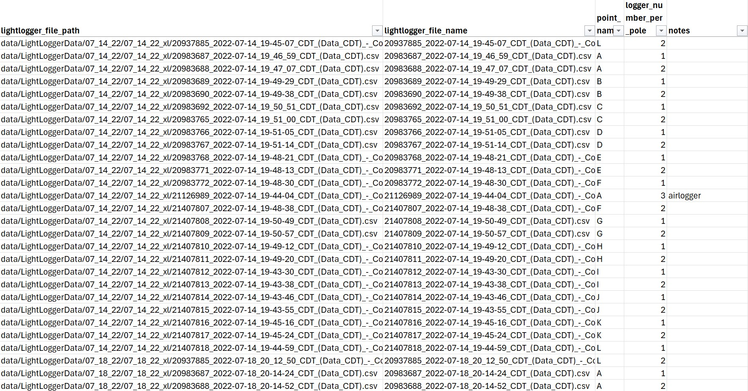
File Paths for Individual Light Loggers
pole_legend.xlxs – Sheet 1 (data_lightloggers)

Slide 28
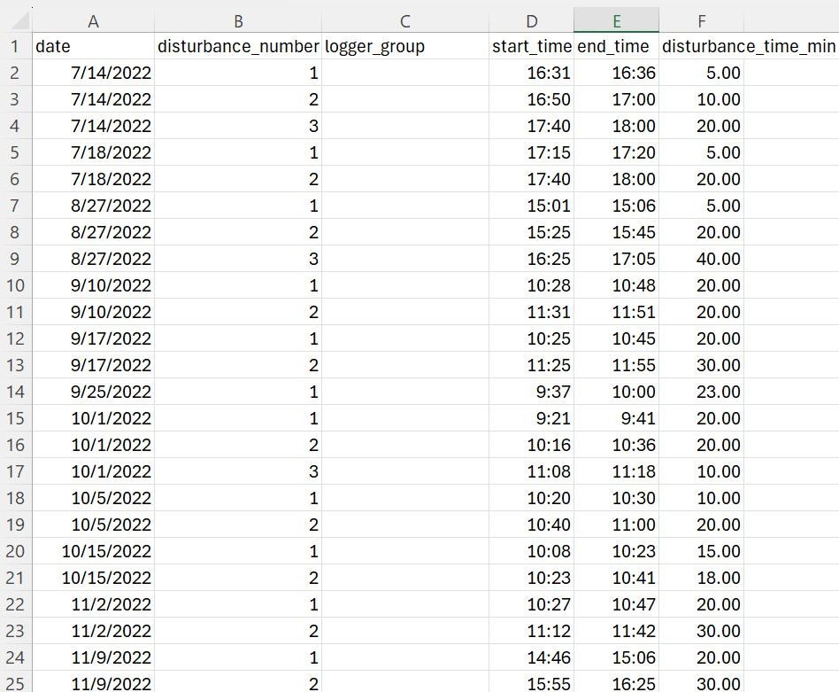
Disturbance Timeframes
pole_legend.xlxs – Sheet 2 (disturbance_periods)

Slide 29
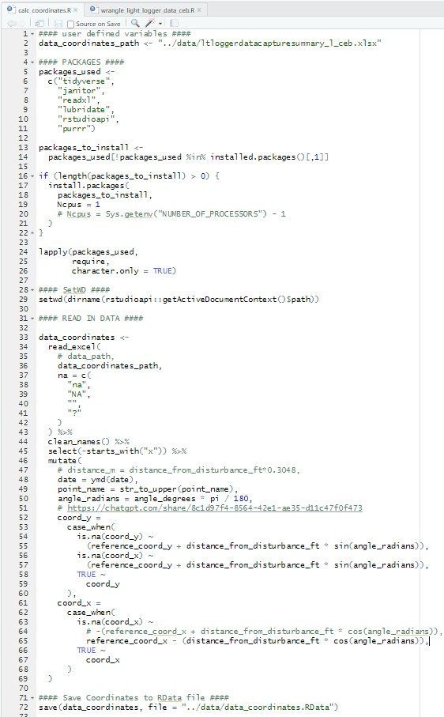
Data Manipulation – Calculating Coordinates

Slide 30
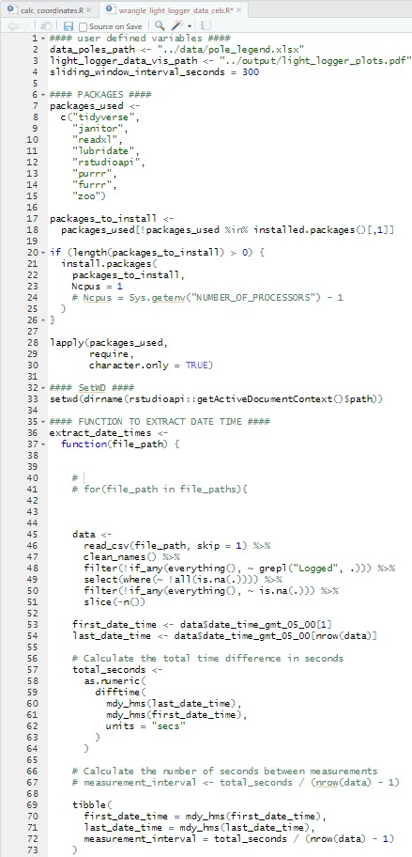
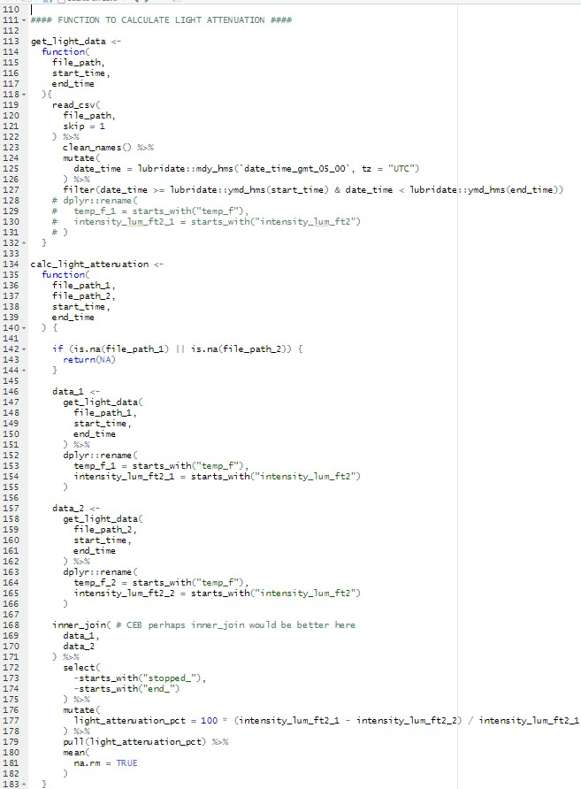
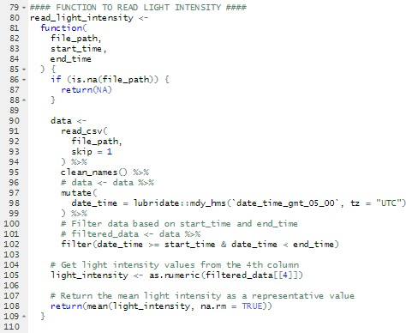
Data Manipulation – Percent Light Attenuation

Slide 31
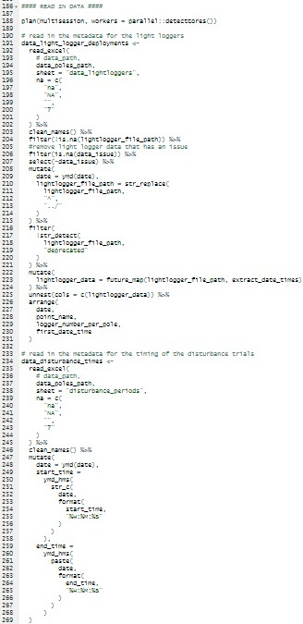
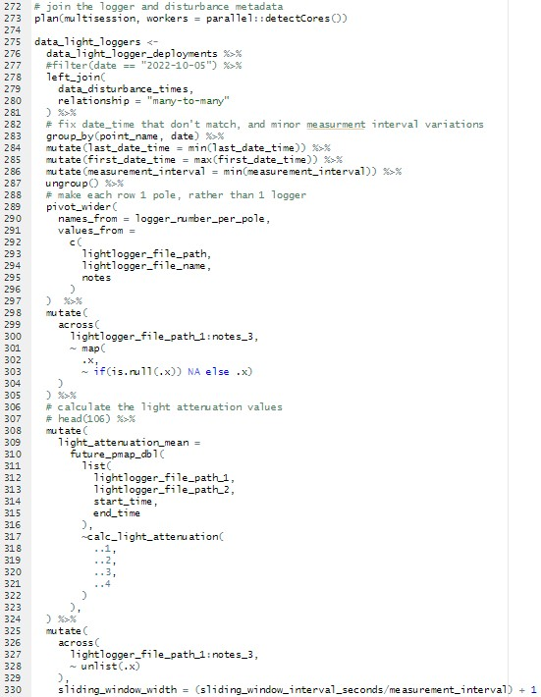
Data Manipulation – Percent Light Attenuation

Slide 32
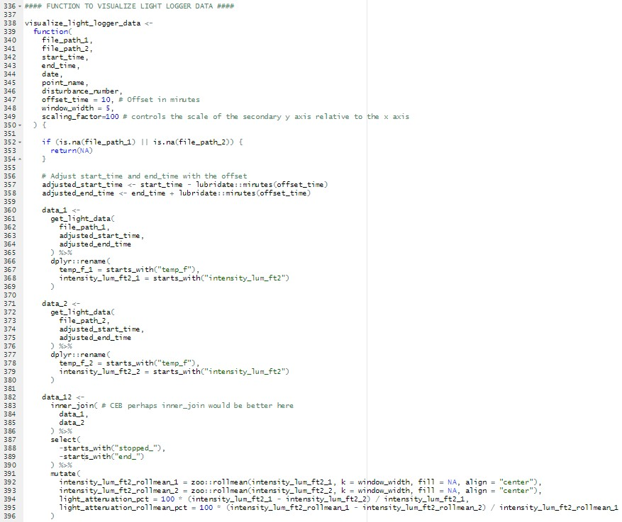
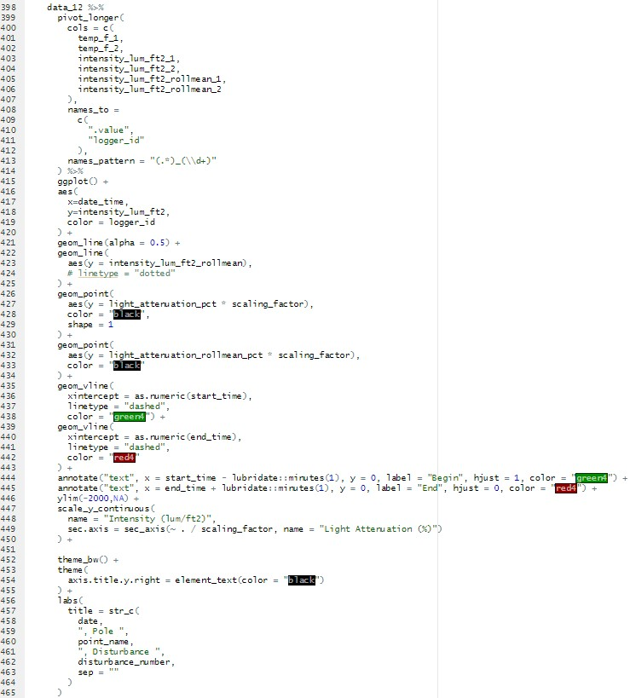
Data Manipulation – Percent Light Attenuation

Slide 33
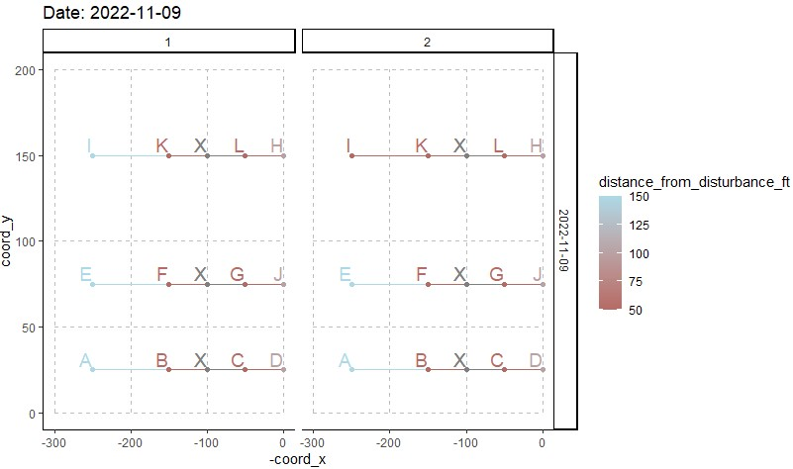
Data Manipulation – Calculating Coordinates
Notes:
Image of all maps at once

Slide 34
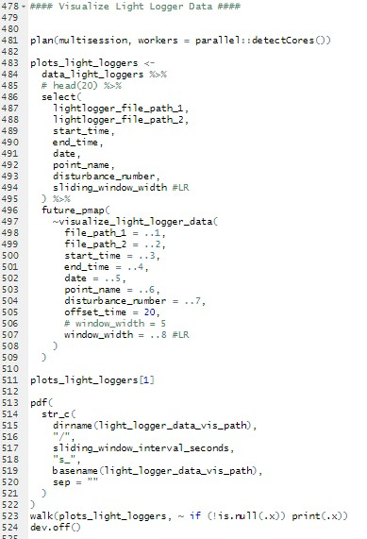
Data Manipulation – Percent Light Attenuation

Slide 35
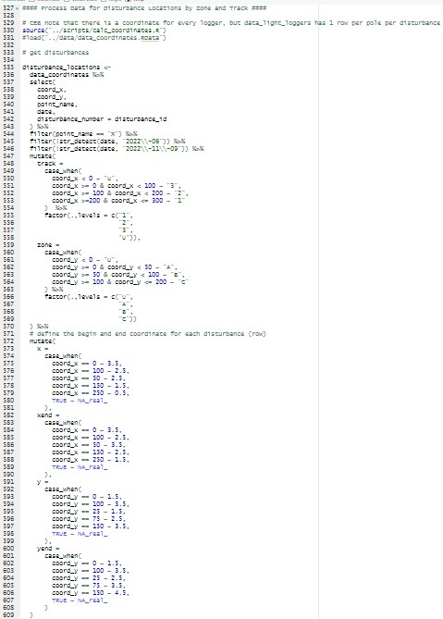
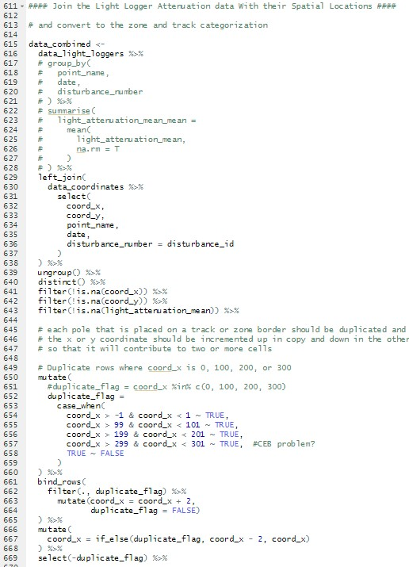
Data Manipulation – Individual Heatmaps

Slide 36
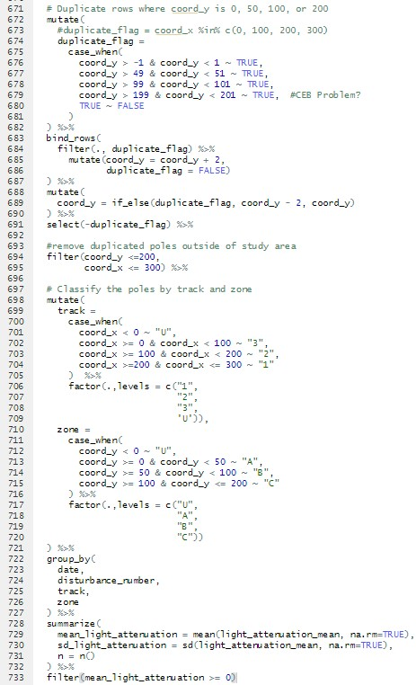
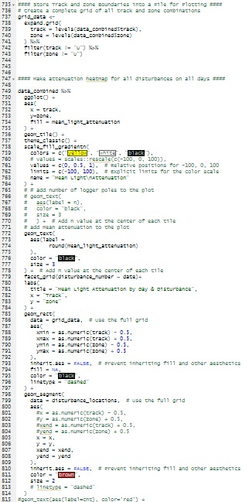
Data Manipulation – Individual Heatmaps

Slide 37
Visualization of Mean Light Attenuation
Notes:
Look at 10-01-2022 – heatmap doesn’t represent
10-01 experiment is the best experiment done. Show one or two tracks/poles. Show 20 or 35ft pole and the 200 ft pole. Timing of plume / timing of attenuation.
Put pdf of databook in repo.

Slide 38
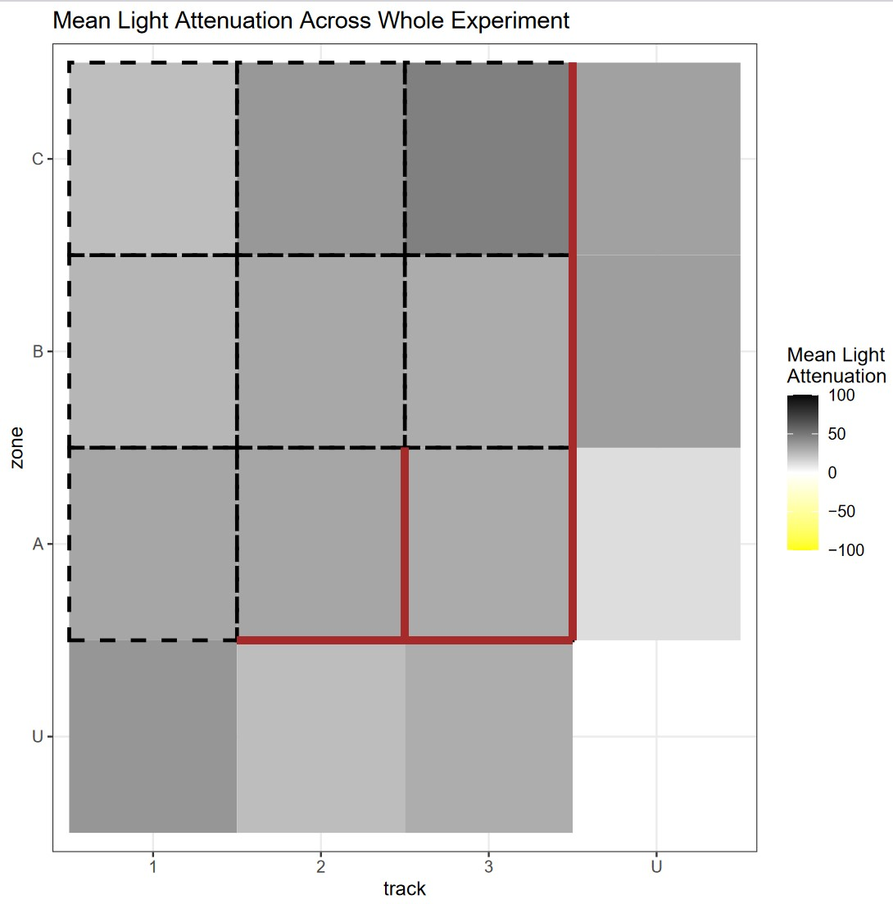
Mean of Mean Light Attenuation
Track 1 Zone A had the least attenuation as hypothesized
Track 3 had the most attenuation as hypothesized
Zone A did not result with the most attenuation as expected
Track 1 upstream and Track 3 Zone C had the most amount of attenuation
Notes:
Disturbances collapsed together.

Slide 39
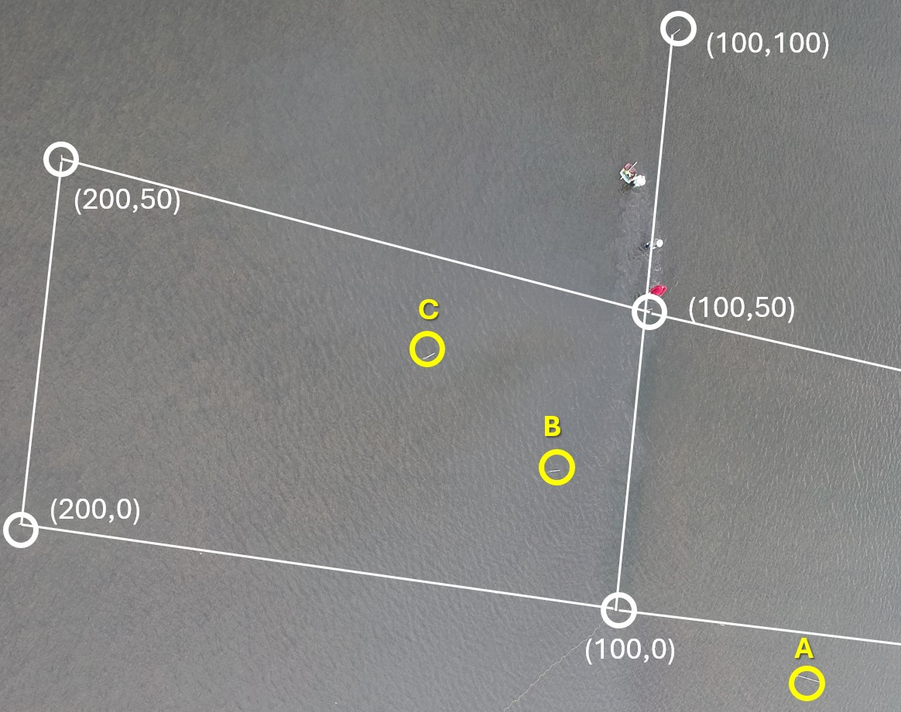
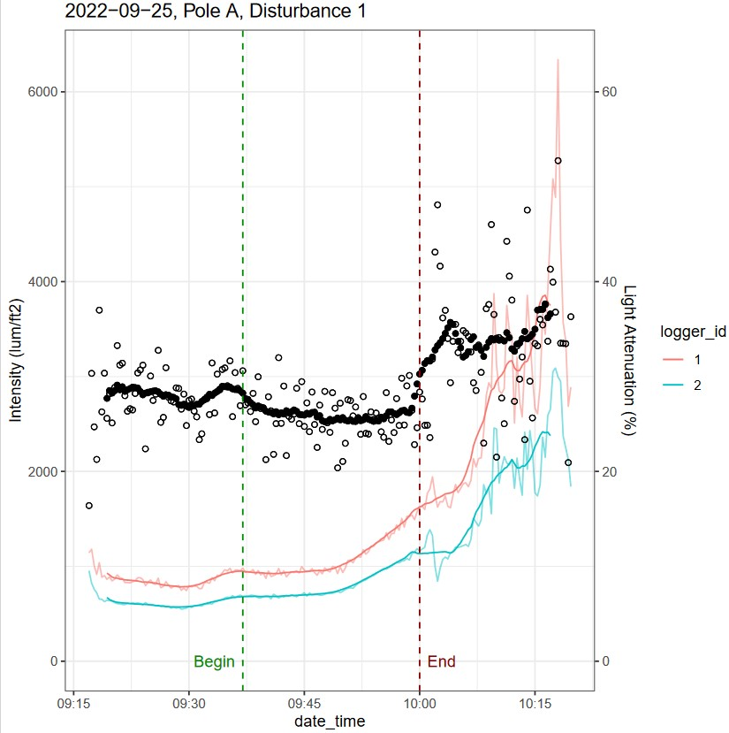
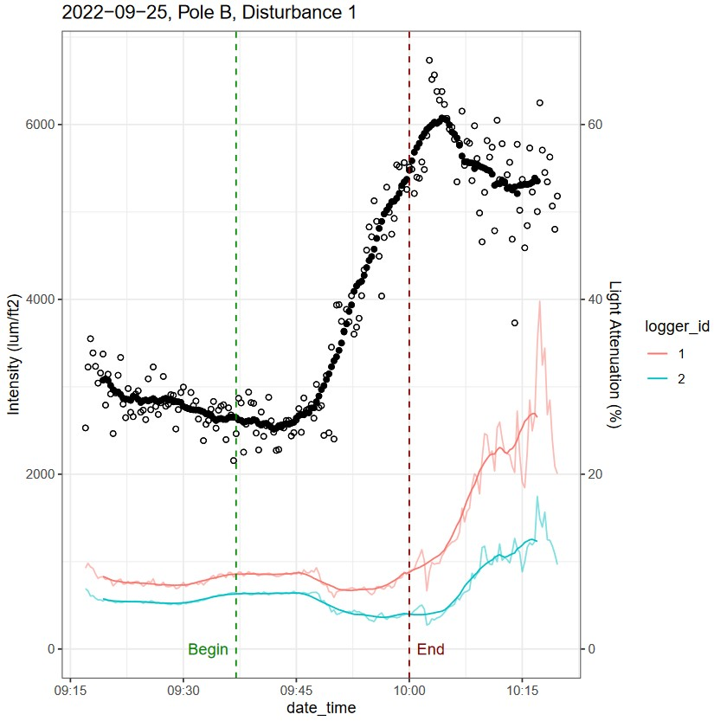
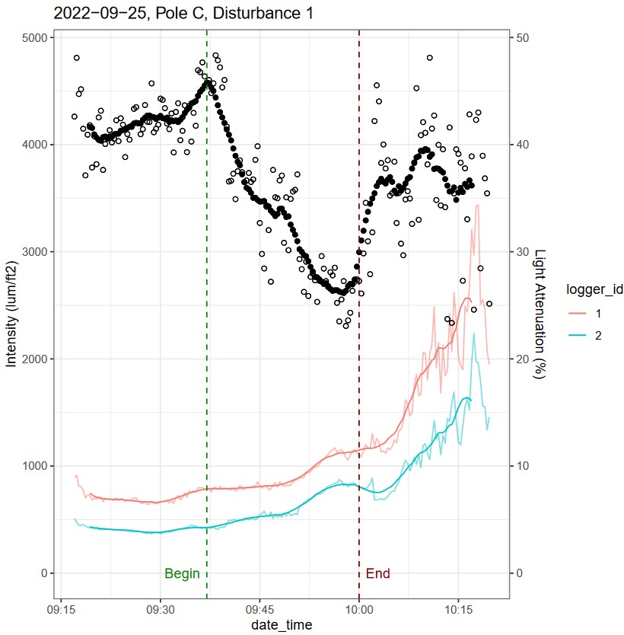
Less Difference in Attenuation than Expected
09-25-22 Disturbance 1 10:00 a.m.
09-25-22 Disturbance 1 10:00 am
Disturbance from (100,0) to (100,50)
Poles located on Track 2 Zone C
Taken 6min after the conclusion of disturbance trial
C
B
A
A
B
C
Notes:
C – attenuation decreased
B – increase in light attenuation
Results in not too much difference, peak not visible because being averaged with C, beginning of B curve taken into account as well
Doesn’t necessarily completely capture what we want
Depth is a factor causing an issue as some areas start darker than others.

Slide 40
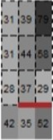





Acceptable Attenuation Values Near Sediment Plume
D
H
L
07-18-2022 6:07 pm
C
G
K
07-18-22 Disturbance 2 6:07 pm
Disturbance from (0,0) to (200,00)
Poles located on throughout all tracks and zones
Taken 7min after the conclusion of disturbance trial
B
F
J
A
E
I
I
J
L
K
Notes:
Image taken 7 mins after end of last disturbance
Disturbance 2 track 3 zone A – ll correlate with the sediment plumes.
Blobs of dead seagrass – not close enough to measure the light measure.
When put poles out there are some lingering sediments – collection of sediment traps that could have altered the reading on light intensity
Expected to see two gradients of sediment plumes.
Find interesting heatmap pattern
Measuring light attenuation is not always reliable
Cahnge titles to point of slide – point anomalies
Put poles where they are
Odd result – title about K and L

Slide 41
Expected Attenuation Values Near Sediment Plume
Notes:
10-01-2022
Change title to descriptive title

Slide 42
Plumes Generated had Finer Scale Impacts than Anticipated
Standard experiments demonstrated the sediment plume not traveling far enough
Scale generated for the plume simulation is too large

Slide 43

Future Applications
Consider inconsistency of current
Adapt scale of impacts to intensity of plume from previous results
Randomize loggers and poles
Because of difference in depth of area, measure 10cm off the surface
Calibrating loggers to each other in standardized environment
Barrier keeping larger debris out (chicken wire)
Notes:
Colored the points rather than the sectors – more accurate way of the plumes being able to generate
Plumes generated had finer scale impacts than anticipated
Shrinking down scale of impact of area 100s of ft to 100ft
Rather than conclusions being problems, change it to how
this methodology can work, but the scale generated for the plume simulation is too large.
See several instances of correlations between plume and attenuation, but sometimes not.
Talk about debris, difference in depth (off bottom rather than off surface)
Calibrating them to each other in standardized environment to correct the loggers
Randomizing loggers and poles – confounds associated with loggers, are not associated with location behind disturbance - Potentially more effective
Have some takeaway messages
Lessons learned on data automation and how it improved the whole process. (correcting a lot of human mistakes)

Slide 44

Data Automation is Instrumental for Organizing Biological Data
Corrects human mistakes
Improves accuracy
Faster data manipulation
Data backups

Slide 45
Obstacles
Inconsistency of the current
Not every sector was sampled equivalently
Current was driven not by wind but a combination of tidal forces and ships going through ship channel 5mi away changing the current drastically
Notes:
We know we targeted sector A of track 3 .
– current not behaved as expected and layout had to be adapted
Not understanding the hydrology was a big problem. (designed with different tracks)

Slide 46
Conclusions
No Correlation between expected heavy disturbance sectors and light disturbance sectors

Slide 47
Future Studies
Net around disturbance area so floating debris does not cover light sensors
Notes:
If I could do this again, what could be done better.

Slide 48
Acknowledgements
Funding Source
Team Members
Dr. Bird
Notes:
Put funding source – part of larger project to study potential impacts of oyster mariculture. (seagrass part)
I would like to express my gratitude to both of my co-chairs, Dr. Kirk Cammarata for letting me into his laboratory research group whose light logger data collection for oyster mariculture interactions with seagrass inspired this project; Dr. Bird, whose Computation for 21st Century Biologists class began my path into RStudio data manipulation knowledge as well as his constant aid during the project development, as well as committee member Dr. Richard Coffin whose Seminar class led me to the practice of professional scientific presentations.
I would also like to thank my family and friends who have supported me through my studies and my fiancé, who has been the foundation, rock, and motor towards my current and future goals and endeavors.

Slide 49

Lab Pictures

Slide 50
Works Cited
Markes, Sarah , and Tim Davenport. “WCS Wild View: The Importance of Seagrass.” Blog.wcs.org, 1 Nov. 2021, blog.wcs.org/photo/2021/11/01/the-importance-of-seagrass/.
San. “San José Island · Texas.” San José Island · Texas, 2019, www.google.com/maps/place/San+Jos%C3%A9+Island/@27.9290843. Accessed 27 Nov. 2024.
Zabarte-Maeztu , Iñigo. “Sign in to Your Account.” Tamucc.edu, Elsevier, 2024, www-sciencedirect-com.manowar.tamucc.edu/science/article/pii/S0141113621002361. Accessed 27 Nov. 2024.

